Slide 1
Budgetary Affairs Committee
Sept 10, 2020
Referrals
Departmental reorganization
Distance education production
Continuing referrals:
Report on the “big picture balance sheet”
Current and next FY budget

Slide 2
School on Earth and Minerals
Geosciences and Geological and Petroleum Engineering
Nuclear Engineering and Radiation Science
Mining and Nuclear Engineering
Chair: Borrok
Chair: (Awauh-Offei, Alajo)
Bai
Dunn-Norman
Flori
Imqam
Wei
Cawlfield
Gertsch
Grote
Maurer
Rogers
Smith
Bunch (Instr)
Eckert
Gao
Hogan
Liu
Locmelis
Mulligan
Oboh-Ikuenobe
Obrist
Wronkiewicz
Yang
Seeger (Lect)
Alajo
Alam
Castaño
Graham
Mueller
Schlegel
Usman
Frimpong
Awuah-Offei
Perry
Alagha
Xu
Sherizadeh
Johnson
Buchely
Lauck
Robertson
Sansone
Phelps
Alobaidan
Casey
Russel
Taber
[Open position]
Taylor
Phelps
Davis

Slide 3
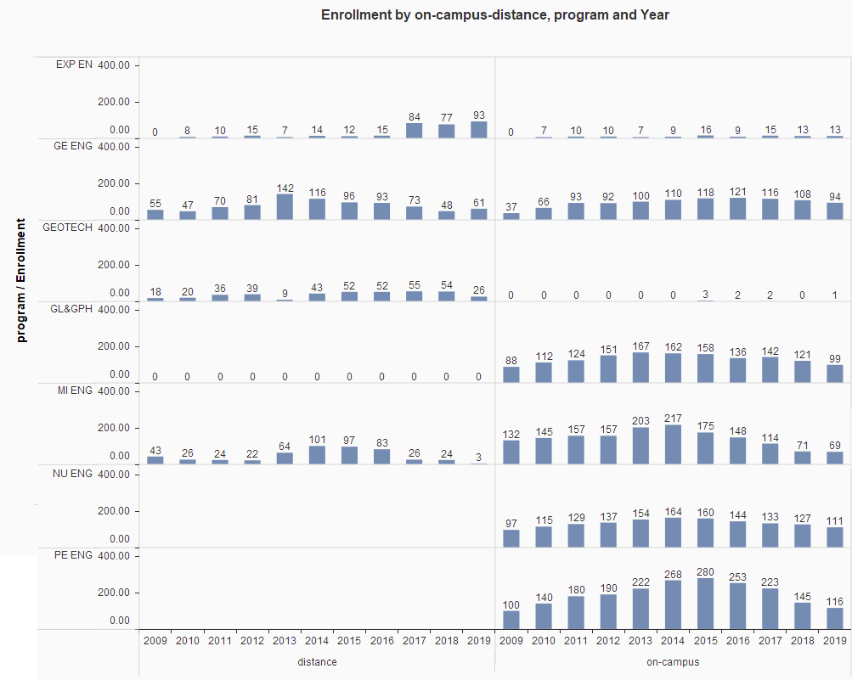

Slide 4
Financial
No change in personnel proposed
Administrative costs: add NERS department chair position, summer month for associate chairs likely, subtract two directors in MNE. Cost similar to routine faculty and administrative turnover.
No change in enrollment predicted, most programs have continuing decline

Slide 5
Distance Education
Tuition and fees charged by degree program, not delivery.
Approx. per credit hour charges:
Nonresident grad $1500
Distance grad 1200 (Not increased this year)
Res grad/military 700
Nonresident UG 1200
Resident UG 550
Distance UG 550

Slide 6
Distance Education
Producers from Global to IT
IT laid off producers or transitioned to other duties
High costs attributed to randomness of course production location and time
Dedicated control rooms and production equipment unable to be used by faculty (e.g. classroom microphones and front cameras off)
Decisions made did not include familiarity with distance education, focus on COVID-19, will evaluate
System may be trying to take over S&T distance

Slide 7
S&T Totals, FY 2020
Residence halls, food, etc.
Must use as specified
Useable money

Slide 8
Budget: where we thought we were

Slide 9
Current fiscal year planned:
Revenue projection
Freshmen flat (?), student total down, higher % resident $ -9.4
State appropriation (withholding possible) - 0.8
Other (auxiliary, etc.) - 1.5
Increased cost expectations
No merit raises = 0% raise pool $ 0.0
Benefit cost increases 1.2
P&T, NTT promotion, PTR awards 0.235
Minimum wage increase 0.3
Golf Team (currently cost not rate) 0.2
IT, insurance, utilities, building repair 0.7
Sum $14.3 = 9% cut
Cut mandate from UM System was 12.5%

Slide 10
Revenue Changes
State funding declining; majority of our income is tuition
Tuition declining not because of student numbers but mix, fewer paying international/out-of-state
Federal COVID relief downplayed ($2.6 million to cover expenses not shown)

Slide 11
Cost Changes
Employees are 74% of costs
Benefit cost increases average 4% annual
Chancident Choi restricting spending: hires require chancellor approval; no pay changes, increases, or job reclassifications; no travel or food purchase.

Slide 12
Budget connects to “in person classes”
Close dorms and food = $15 MM loss
lose ~$7 million in transfers into operating budget,
offset by layoff most of res life,
have to pay bonds on residence halls ($6.4 MM) and some utilities ($1 MM)
(learning situation here may be better than home)
Tuition:
Some withdrawals/drops = partial refunds
Fewer students in spring = lower tuition and fee revenue
Students might demand refunds for loss of in-person quality; refunds on some services
Might System/State punish S&T for ‘shutdown’?

Slide 13
Good news
There is no good news
But plan for this year, FY 2021, conservative
State allocated more $ than expected, -$0.8 MM planned, but allocation is no change [State revenue projected down 10% might cause withholding, 10% is -4.3 MM]
Budget cut mandated by UM is 12.5%, but 9% is estimated reality

